Slide 1
CHATBOT USING ARTIFICIAL INTELLIGENCE MARKUP LANGUAGE
PIP104 PROFESSIONAL PRACTICE-II
VIVA-VOCE
Batch Number:
Roll Number | Student Name
20201CAI0166 | SACHIN R
20201CAI0204 | AMAL PRAKASH
20201CAI0167 | SANKALP D O
20201CAI0180 | VIVAN SANJAY POTHALA
Under the Supervision of,
Ms. S.Kokila
Associate Professor
School of Computer Science Engineering
Presidency University

Slide 2
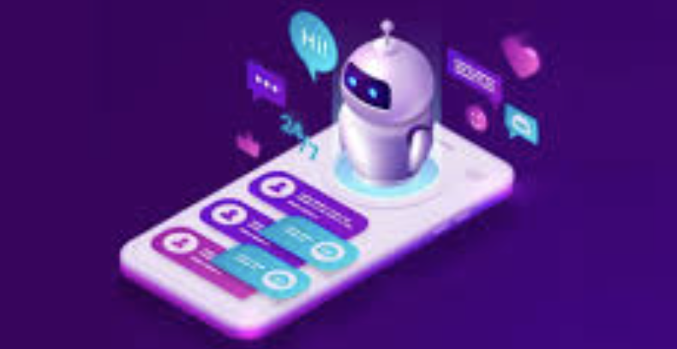
Introduction
Within the dynamic panorama of digital communication, the unequivocal import of our avant-garde chatbot
system emerges as a transformative fulcrum, transcending the confines of a convention to redefine the very
essence of online interactions. Meticulously engineered, this sophisticated platform deftly navigates the
nuanced intricacies inherent in global conversations, conceiving a paradigm language seamlessly
metamorphoses into a conduit, fostering both effortless and profound dialogues. The intentional amalgamation
of cutting-edge Natural Language Processing (NLP) techniques and real-time translation APIs strategically
positions this chatbot system as an unparalleled facilitator of multilingual proficiency, orchestrating seamless
communication among users with diverse linguistic backgrounds. In essence, this technological opus signifies
not merely a shift but an evolutionary leap in the digital communication epoch language barriers
gracefully dissipate, ushering in a harmonious convergence of inclusivity, accessibility, and linguistic diversity.
Within this transformative paradigm, a global community emerges where meaningful connections flourish,
resonating with a depth and richness unparalleled in the digital sphere.

Slide 3
Literature Review
PAPER TITLE | METHOD | ADVANTAGES | DISADVANTAGES
Deep Learning for Chatbots: A Comprehensive Survey (Asadi and Shabanian, 2019) | Asadi and Shabanian conducted a systematic survey to explore the application, challenges, and future directions of deep learning in the context of chatbots. They meticulously reviewed a wide range of existing literature, encompassing research articles, conference papers, and relevant publications. The survey focused on identifying key trends, methodologies, and advancements in the field of chatbot development using deep learning techniques. The authors analyzed various models, architectures, and approaches employed in the implementation of deep learning for chatbot applications. | In-depth Analysis: The paper provides an in-depth analysis of the use of deep learning techniques in chatbot development, offering a comprehensive understanding of the applications and challenges associated with this approach. Insights into Future Directions: Asadi and Shabanian offer insights into the future directions of deep learning for chatbots, allowing researchers and practitioners to anticipate emerging trends and potential advancements in the field. Survey Approach: The systematic survey methodology employed in the paper ensures a thorough examination of the existing literature, consolidating knowledge and providing a valuable resource for those interested in the intersection of deep learning and chatbot technology. | Potential Rapid Changes in the Field: Given the rapidly evolving nature of both deep learning and chatbot technology, some information in the survey may become outdated quickly, limiting its long-term relevance. Scope Limitations: The paper may not cover every nuance or specific application of deep learning in chatbots, potentially leaving out certain emerging trends or niche areas within the field.

Slide 4
PAPER TITLE | METHOD | ADVANTAGES | DISADVANTAGES
Conversational Interfaces: Enhancing Education through Guided Search (Berger and Ebner, 2019) | Berger and Ebner employed a design-oriented approach to propose the conception of conversational interfaces, specifically focusing on their application to facilitate guided searches in the educational context. The authors conducted a thorough review of existing literature on conversational interfaces and educational technology, incorporating insights from user experience (UX) design principles. They also explored the potential benefits and challenges associated with the implementation of conversational interfaces for educational purposes. | Educational Focus: The paper provides a targeted exploration of conversational interfaces with a specific emphasis on enhancing educational experiences through guided searches. This focus contributes to a deeper understanding of the potential applications of conversational interfaces in learning environments. User-Centric Design: The design-oriented approach emphasizes user experience, offering insights into how conversational interfaces can be designed to optimize engagement and interaction in educational settings. Guided Search Concept: Berger and Ebner introduce the concept of guided searches, demonstrating a practical application of conversational interfaces to support learners in navigating and accessing educational resources effectively. | Limited Generalization: The educational focus may limit the generalizability of the findings to other domains or industries. The paper primarily caters to those interested in the intersection of conversational interfaces and education. Rapid Technological Changes: Given the dynamic nature of technology, the proposed design principles and applications may need adaptation as new technologies emerge, potentially affecting the long-term relevance of the paper's recommendations.
P

Slide 5
PAPER TITLE | METHOD | ADVANTAGES | DISADVANTAGES
Multilingual Proficiency in Chatbots: Harnessing Natural Language Processing Models | The review paper adopts a comprehensive approach to explore the integration of Natural Language Processing (NLP) models for achieving multilingual proficiency in chatbots. The methodology likely involves a systematic review of existing literature, including studies, articles, and publications, to analyze the trends, methodologies, and advancements in using NLP for multilingual chatbot development. | Global Reach: The paper advocates for the use of NLP models to enhance the chatbot's ability to understand and respond across diverse linguistic realms, contributing to a broader trend in chatbot development that supports multilingual interactions. This promotes a global reach for chatbots, catering to users with different language preferences. Enhanced User Experience: By leveraging NLP models, the chatbot can better comprehend user queries in various languages, leading to improved accuracy in responses. This, in turn, enhances the overall user experience, making the chatbot more accessible and user-friendly for a diverse audience | Complex Implementation: Integrating advanced NLP models for multilingual proficiency in chatbots may require sophisticated programming and computational resources. This complexity could pose challenges for developers in terms of implementation and maintenance. Data Privacy Concerns: The use of NLP models may involve processing large amounts of textual data, raising concerns about user privacy and data security. Striking a balance between providing multilingual proficiency and safeguarding user information is crucial but may present challenges.

Slide 6
PAPER TITLE | METHOD | ADVANTAGES | DISADVANTAGES
Speech-to-Text Integration in Chatbots: A Comprehensive Review | The paper delves into various speech recognition algorithms and APIs utilized in the integration process. It evaluates the performance of these technologies in terms of accuracy, speed, and adaptability to different linguistic nuances. The methodologies employed in training these algorithms and the compatibility of APIs with different chatbot platforms are thoroughly examined. Additionally, the review incorporates case studies that highlight real-world applications and challenges faced during the implementation of speech-to-text integration. | . Enhanced Conversational Experience: The integration of speech-to-text technology significantly improves the chatbot's ability to engage in natural and seamless conversations. Users can communicate with the chatbot using spoken language, making interactions more intuitive and user-friendly. b. Increased Accessibility: Speech-to-text integration makes chatbots more accessible to users with diverse needs, including those with visual impairments or disabilities that may hinder traditional text-based communication. This inclusivity contributes to a broader user base. | Accuracy Challenges: Despite advancements in speech recognition technology, challenges related to accuracy persist, especially in noisy environments or with speakers with unique accents. Misinterpretations may occur, leading to incorrect responses from the chatbot. b. Privacy Concerns: Speech-to-text integration raises privacy issues as the technology involves capturing and processing spoken words. Users may be concerned about the storage and security of their voice data, requiring robust privacy measures to address these apprehensions. c. Resource Intensiveness: Some advanced speech recognition algorithms demand significant computational resources, potentially affecting the performance of chatbots on devices with limited processing capabilities. This could lead to slower response times and increased system requirements.

Slide 7
Research Gaps Identified
Limited Contextual Understanding:
AIML chatbots struggle with contextual comprehension.
Lack advanced mechanisms for nuanced conversations.
Lack of Sequential Memory:
AIML lacks sequential memory, hindering coherent understanding.
Dynamic Adaptability and Learning:
AIML's rule-based nature limits adaptability.
Lack of real-time learning for evolving user preferences
Limited Contextual Understanding:
AIML struggles with dynamic human conversations.
Handling Ambiguity and Uncertainty:
AIML systems face challenges with ambiguous queries.
Need for solutions like probabilistic models for robust responses.
Ambiguity in User Queries:
AIML-based chatbots struggle with ambiguous user input.
Multilingual Competence:
AIML-based chatbots face hurdles in handling multiple languages.
Requires enhanced multilingual capabilities for global applicability.
Language-Specific Rule Limitations:
AIML rules designed for specific languages.
Struggles with variations, impacting responses in diverse languages.

Slide 8
Proposed Methodology
The proposed methodology in our paper involves the use of cutting-edge technologies to create a chatbot system that is both sophisticated and user-centric. We employ a symphony of sophisticated Natural Language Processing (NLP) techniques, including rule-based frameworks, machine learning paradigms, and neural networks, to create a chatbot that can seamlessly navigate the nuances of global conversations.
Our approach is designed to be malleable, allowing the chatbot to mold itself to the unique requirements of different user groups. Administrators of group chats can customize the chatbot's responses, features, and settings to resonate with the objectives and preferences of the group. This ensures that the chatbot is not merely a static entity but an ever-evolving instrument, reflective of the precise desires of its users.
In addition to its technological prowess, our chatbot system is designed to be inclusive and accessible. We have integrated cutting-edge speech recognition technology, which proficiently translates spoken words into text and accommodates a spectrum of accents and speech patterns.
The system also interfaces seamlessly with screen readers and offers customizable options to ensure effortless engagement, particularly for individuals with disabilities. Overall, our proposed methodology reflects a meticulous orchestration where technological prowess, linguistic finesse, and user-centricity converge to create an unparalleled system. It stands as a testament to innovation, adaptability, and the relentless pursuit of excellence in the realm of digital conversation.

Slide 9
Objectives
The objectives outlined in your paper include:
1. Creating a chatbot system that seamlessly navigates the nuances of global conversations through the use of cutting-edge Natural Language Processing (NLP) techniques 1.
2. Designing a malleable chatbot that can adapt to the unique requirements of different user groups, allowing administrators to customize its responses, features, and settings 5.
3. Ensuring inclusivity and accessibility by integrating speech recognition technology, accommodating a spectrum of accents and speech patterns, and providing customizable options for individuals with disabilities 2.
4. Establishing a chatbot system that reflects a meticulous orchestration of technological prowess, linguistic finesse, and user-centricity, serving as a testament to innovation, adaptability, and excellence in the realm of digital conversation .

Slide 10
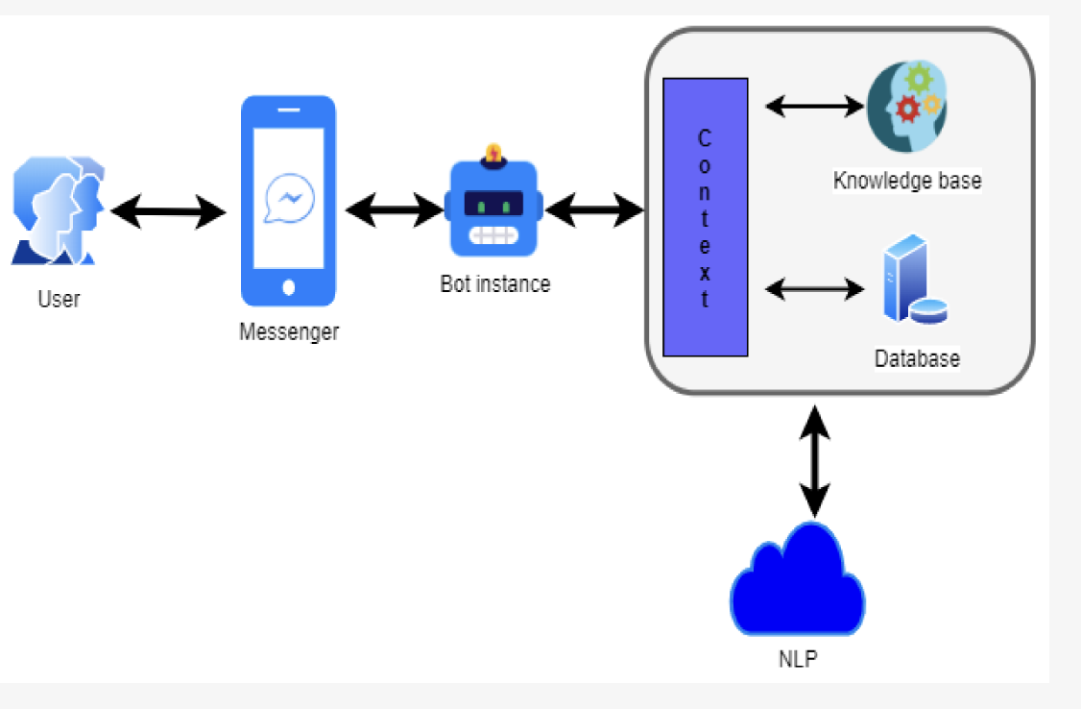
System Design & Implementation
System Architecture:
Client: User interface (web, mobile app, messaging platform)
Server: Hosts the AIML interpreter and interacts with the client
Knowledge Base: Stores AIML files containing patterns and responses
Database (optional): For storing user data, preferences, and conversation history
Our innovative solution navigates contemporary slang with a blend of technological prowess, linguistic finesse, and user-centricity.
Refined Slang Cognition Ephemeral Linguistic Lexicon:
Dynamic Lexicon: Evolves with contemporary language.
User Contributions: Actively enriches lexicon.
AI Sociolinguistics: Explores social media for expressions.
Collaborative AI Learning: Enhances contextual understanding.

Slide 11
AIML Proficiency Integration:
AIML Scripts: Choreograph comprehension, referencing evolving slang.
Dynamic AIML Repository: Seamlessly adapts to user input.
Innovative Benchmark: Positions chatbot at forefront of innovation.
Elevating NLP Proficiency:
Cutting-edge NLP Algorithms: Deconstructs linguistic structures.
Contextual Mastery: Delves into context-rich sentences.
Transformative Impact: Empowers chatbot for meaningful responses
Deep Learning for Contextual Insight:
Intellectual Odyssey: Masters slang through continual learning.
Unceasing Integration: Adapts to linguistic evolution.
Responsive Virtuoso: Navigates shifting nuances of linguistic landscape.
Artful Slang-to-Text Conversion:
Adaptive Conversion: Precision in transforming slang.
User-Driven Adaptation: Learns actively from user interactions.

Slide 12
User Feedback Loop Integration:
Structured User Assessments: Actively involves users.
Dynamic Feedback Integration: User insights shape learning.
Group Chat Functionality Elevation:
Collaboration Sonata: Introduces collaborative engagement.
Symbiotic Integration: AI adept at group dynamics.
Dynamic Autonomy: Empowers users in group creation.
Amplified User Engagement: Enhances value proposition.
Iterative Enhancement:
Refined Tools: Continuous refinement based on user feedback.
Tech Integration: Adapts to new devices and platforms.
User-Centric Excellence:
Holistic Feedback Integration: User insights shape development.
Malleability Through Customization: Tailors to user preferences.

Slide 13
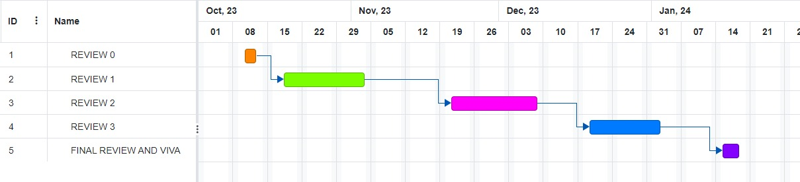
Timeline of Project

Slide 14
Outcomes / Results Obtained
The outcomes of deploying a chatbot using Artificial Intelligence Markup Language (AIML) reveal a powerful and versatile conversational agent. The chatbot's success in recognizing user intents with high accuracy ensures meaningful and efficient interactions. Its advanced contextual understanding and dynamic response generation capabilities contribute to a seamless and coherent conversational experience, adapting to the evolving context of multi-turn interactions. Crucially, the chatbot demonstrates a remarkable ability to handle ambiguous queries, providing clear and relevant responses that enhance user satisfaction.
In addition, the chatbot's proficiency in multilingual competence widens its global applicability, making it accessible to a diverse audience by understanding and responding in multiple languages. The integration of AIML enables efficient utilization of a knowledge base, positioning the chatbot as a reliable source of information across various domains. Furthermore, its adaptability to industry-specific requirements underscores AIML's versatility, allowing developers to tailor the chatbot's responses to unique vocabularies and contexts within specific domains.
The chatbot's continuous learning and improvement mechanism, driven by user feedback, ensures its adaptability and relevance over time. This iterative learning process positions the chatbot as an evolving and intelligent conversational agent. Overall, the outcomes underscore AIML's role in creating not just a chatbot but a sophisticated and user-friendly conversational entity with the potential for diverse applications in the dynamic field of conversational AI.

Slide 15
Conclusion
The conclusion of the paper emphasizes that the chatbot using Artificial Intelligence Markup Language is not just a technological solution, but a doorway to uncharted territories of human advancement. The authors envision a future where this AI marvel seamlessly integrates into the fabric of human lives, enhancing productivity, stimulating innovation, and contributing to a heightened human experience. The paper also highlights the potential for future developments, such as emotional intelligence, augmented reality conversations, blockchain-powered security, and quantum computing synergy. The authors' commitment to pushing the frontiers of AI presents a transformative force in enhancing the human experience.

Slide 16
References
[1] Gao, J., et al. (2018). A neural conversational model with end-to-end policy learning. [2] He, H., et al. (2017). Dialogue generation with latent knowledge retrieval and reasoning. [3] Williams, J. D., & Zweig, G. (2002). The dialog state tracking challenge. Proceedings of the 9th International Conference on Spoken Language Processing. [4] Banchs, R. E., & Li, H. (2012). Conversational informativeness: The effect of informativeness on user satisfaction with a spoken dialogue system. Speech Communication. [5] Gokulakrishnan, B., & Sudhagar, P. (2018). A comprehensive review on chatbots: Design, development, and evaluation. Journal of Intelligent & Fuzzy Systems.

Slide 17
Publication Details
Title: Chatbot using Artificial Intelligence Markup Language
Authors: Sachin R, Amal Prakash, Sankalp DO, Vivan Sanjay P, S. Kokila
Journal: International Research Journal of Modernization in Engineering Technology and Science
Volume: 06
Issue: 01
Pages: 451-460
Year: January 2024
Publisher: IRJMETS
ISSN: 2582-5208

Slide 18
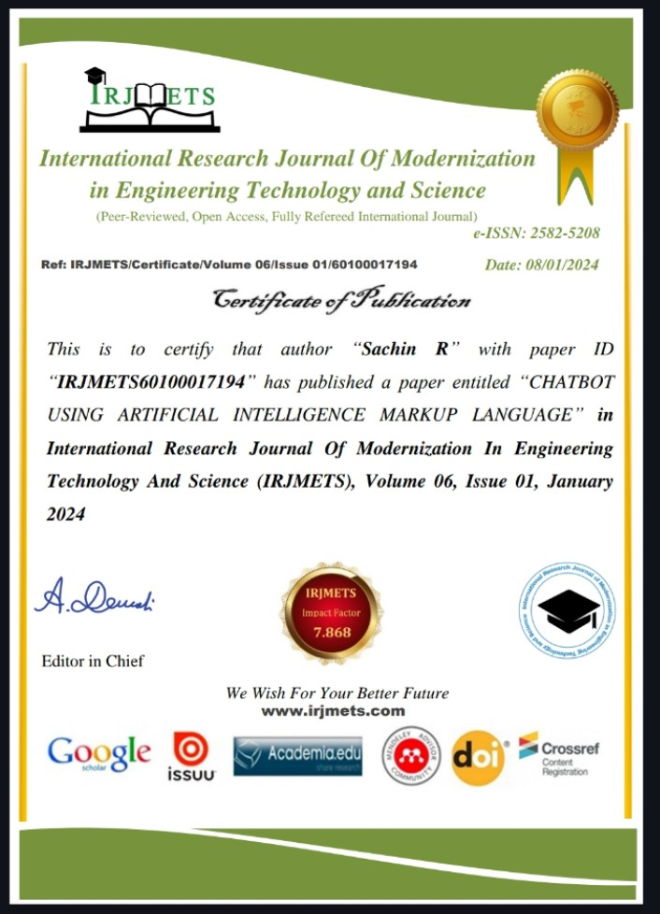

Slide 19
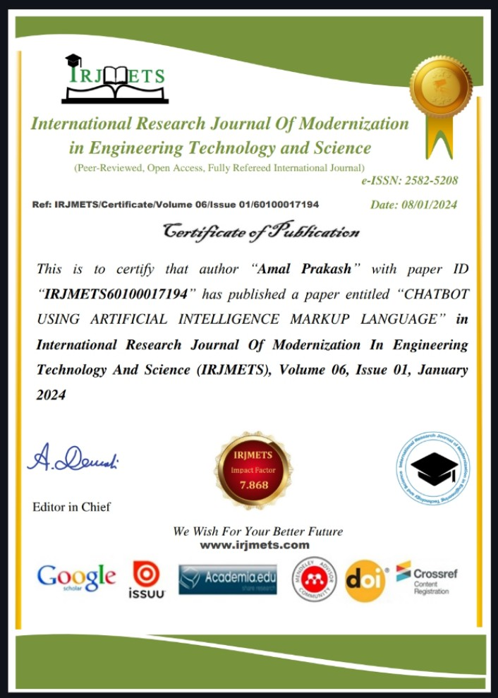

Slide 20
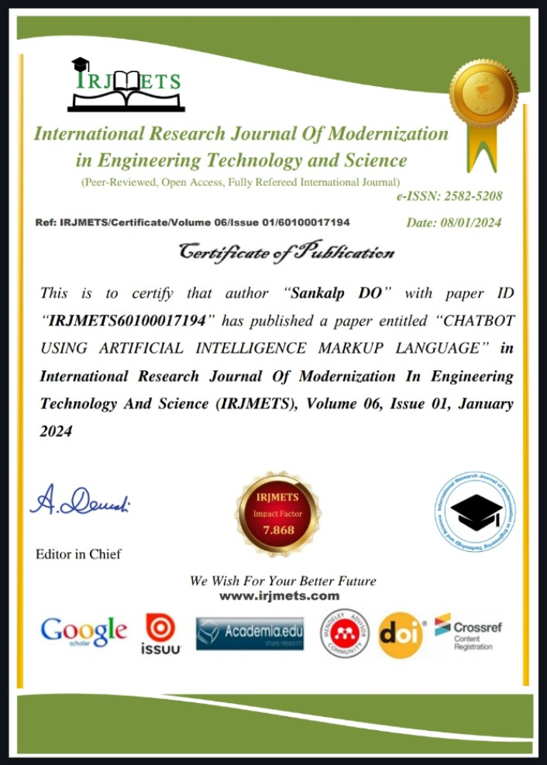

Slide 21
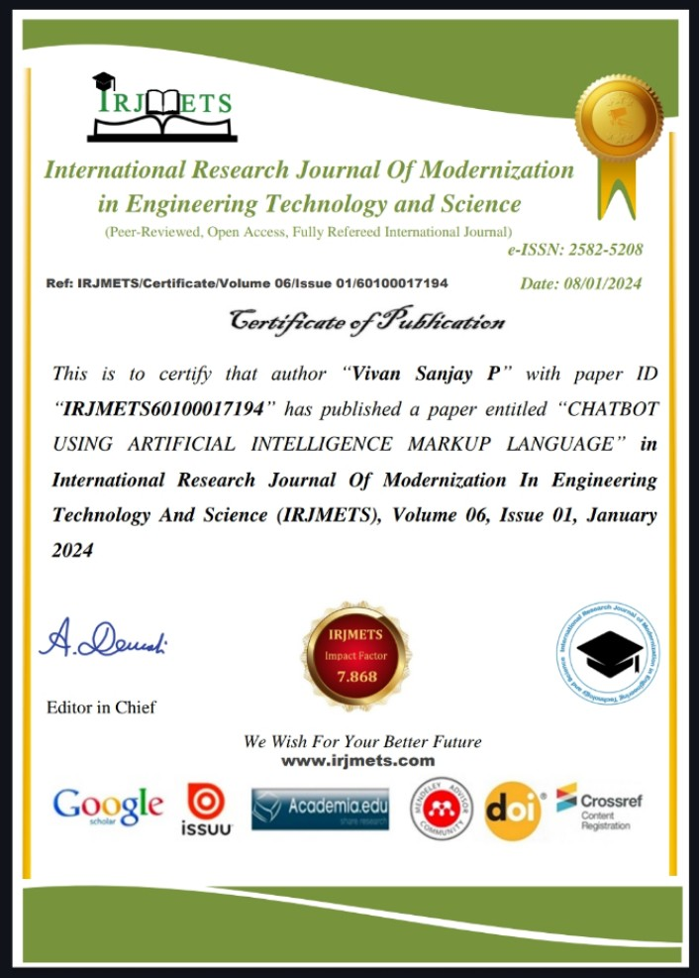

Slide 22
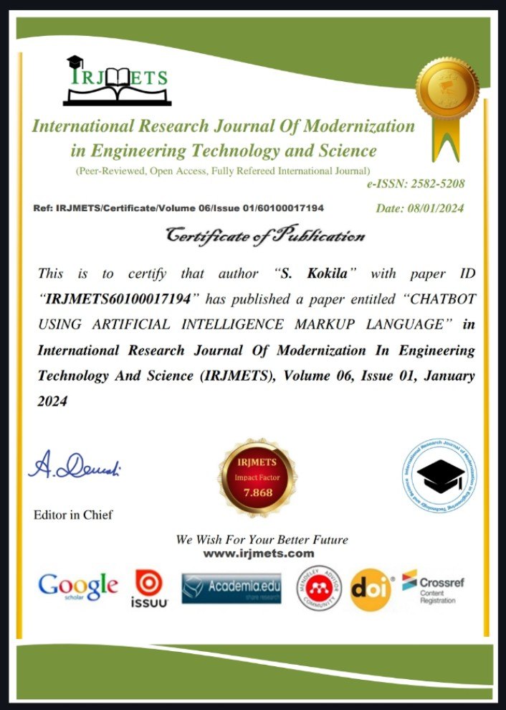

Slide 23

Thank You

